Slide 1

Mohanlal Sukhadia University
University College of Science
2020-21
Topic: ERP For Sohn Mariens Hospital and Labs
Submitted by:
Ali Asger Habib
BCA 5th Semester
Submitted to:
Dr. Avinash Panwar

Slide 2
Table of Content:
Project Title
Project Introduction
Aim of the project
Technical Specifications
Project Modules
Database Structure
Future Scope of the project

Slide 3

ERP For Sohn Mariens Hospital and Labs

Slide 4
Project Introduction:
The aim of developing ERP for a hospital system is to replace the traditional way of managing the information related to health care and aids in the job completion of health care providers with computerized system.
Another important reason to introduce HMS was to solve the complications coming from managing all the paper works of every patient associated with the various departments of hospitalization with confidentiality.
ERP for a hospital system has a very large scope. This PHP project can be used by any hospital or clinic for keeping the records of their patients, staff and other assets.
This project is easy, fast and accurate. It requires less disk space. Online Hospital Management System uses MySQL Server as backend so there is not any chance of data loss or data security.

Slide 5

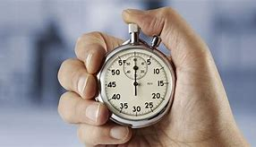
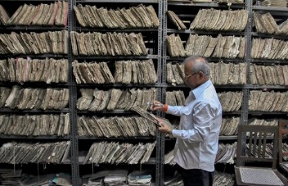


Slide 6
Technology Used:

Slide 7






Languages:

Slide 8

Database:

Slide 9
Technical Requirements:

Slide 10
Hardware Requirements:
Processor : Intel I3 4th Generation
RAM : 512 MB
Hard Disk : 80 GB

Slide 11




Software Requirements:

Slide 12
Data Flow Diagrams:

Slide 13
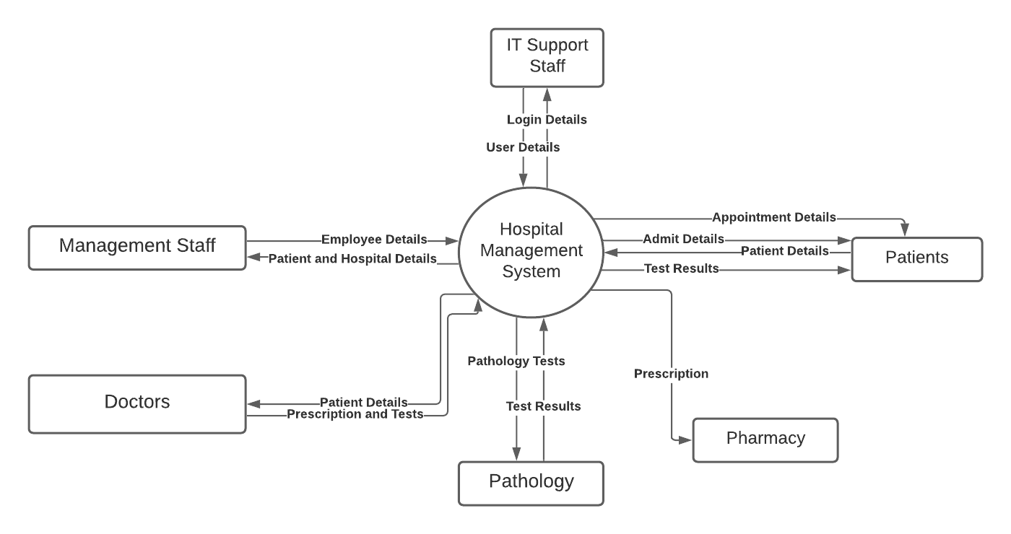
Level 0:

Slide 14
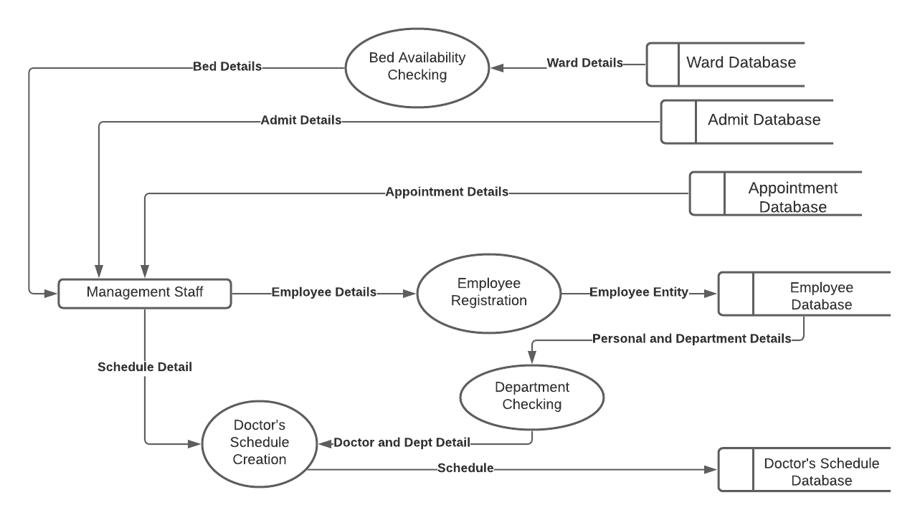
Level 1 for Management:

Slide 15
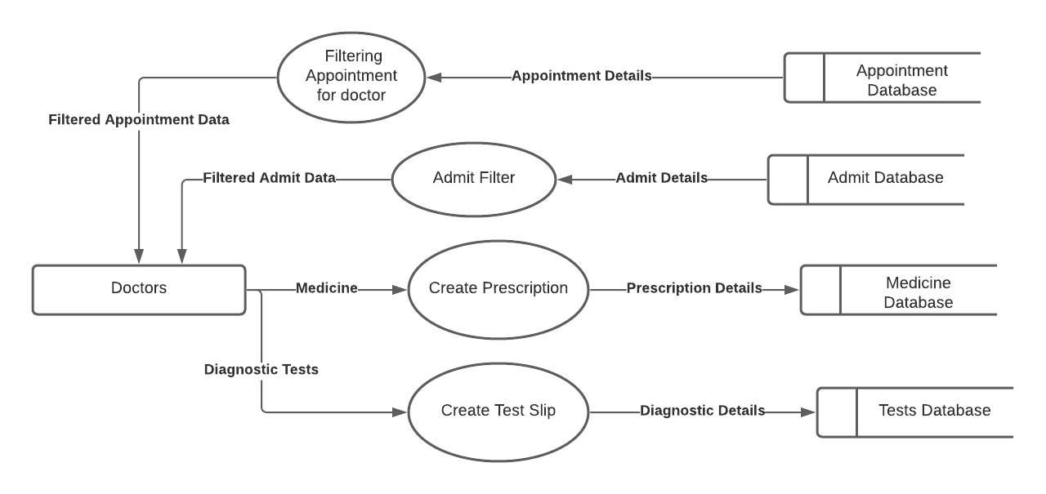
Level 1 for Doctor:

Slide 16
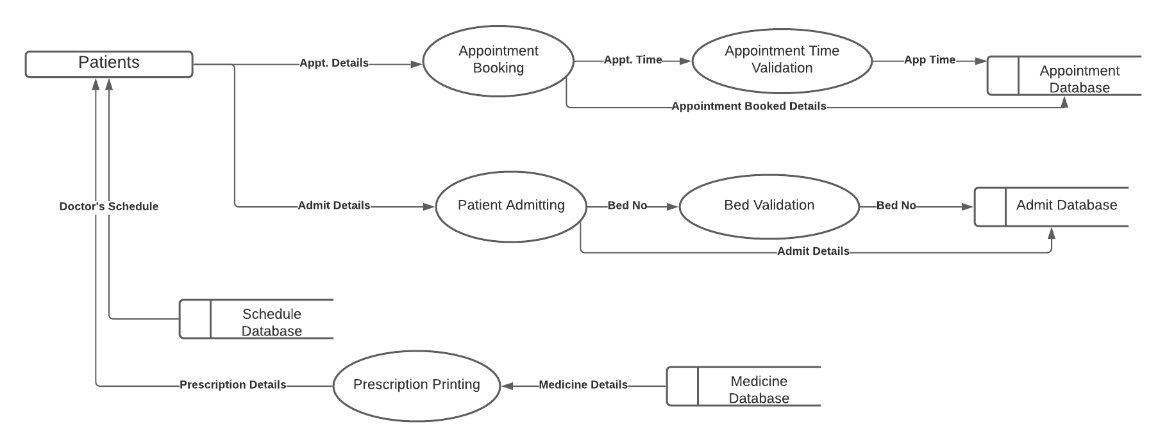
Level 1 for Patients:

Slide 17
Level 1 for IT Support:

Slide 18
Project Modules:

Slide 19
This project has four major modules: 1. Management Module 2. Reception Module 3. IT Support Module 4. Doctor Module

Slide 20
Login Page:
This page is the home page of the web application. This page allows the users to log into their accounts.

Slide 21
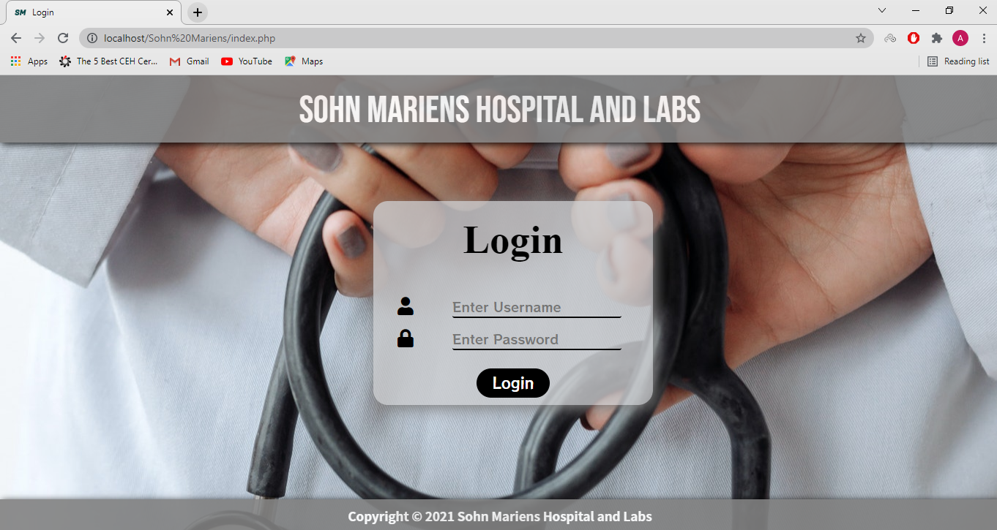

Slide 22

Management Module:

Slide 23
Dashboard:
The dashboard of the management module contains the table containing the login and logout details of every staff member.

Slide 24
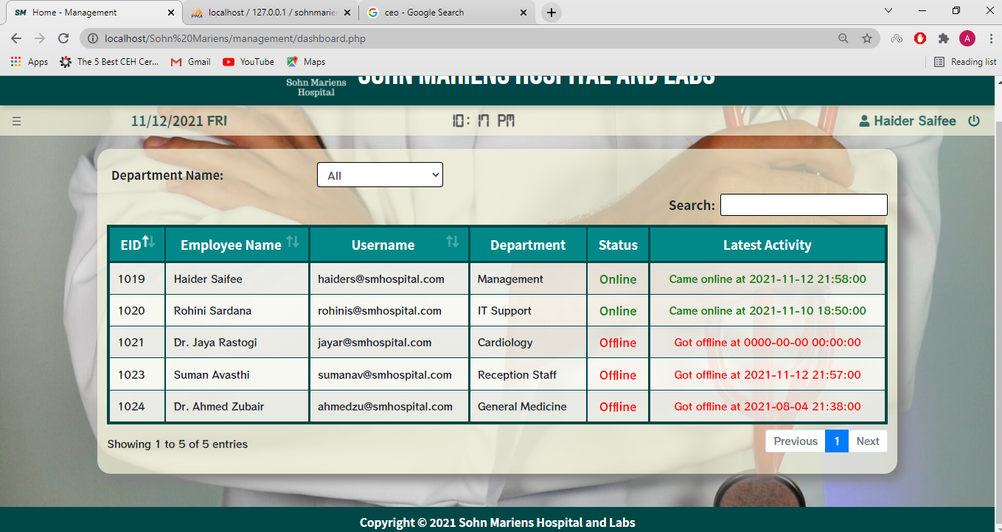

Slide 25
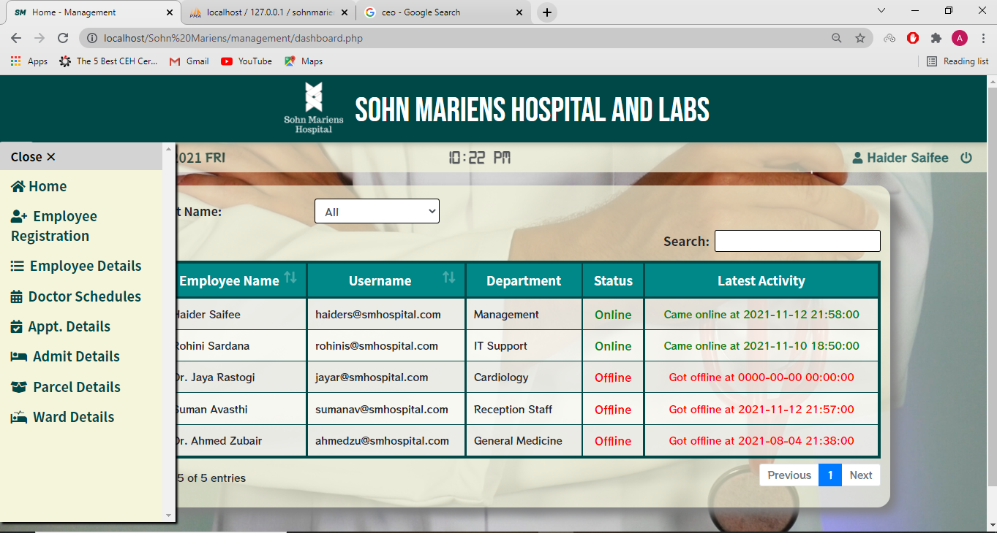

Slide 26
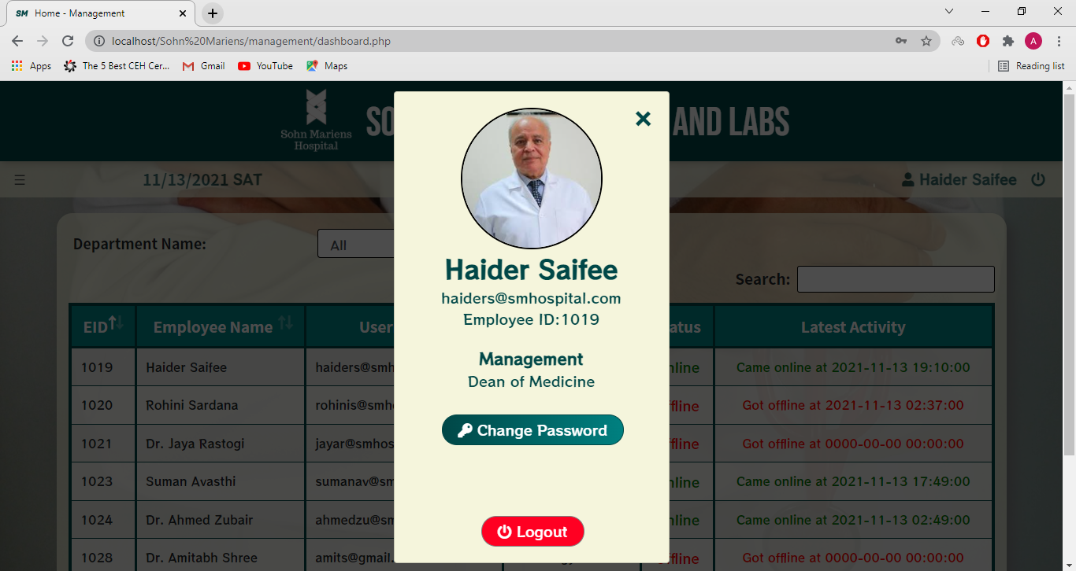

Slide 27
Employee Registration:
This functionality creates the employee details and thus registers them into the system.

Slide 28
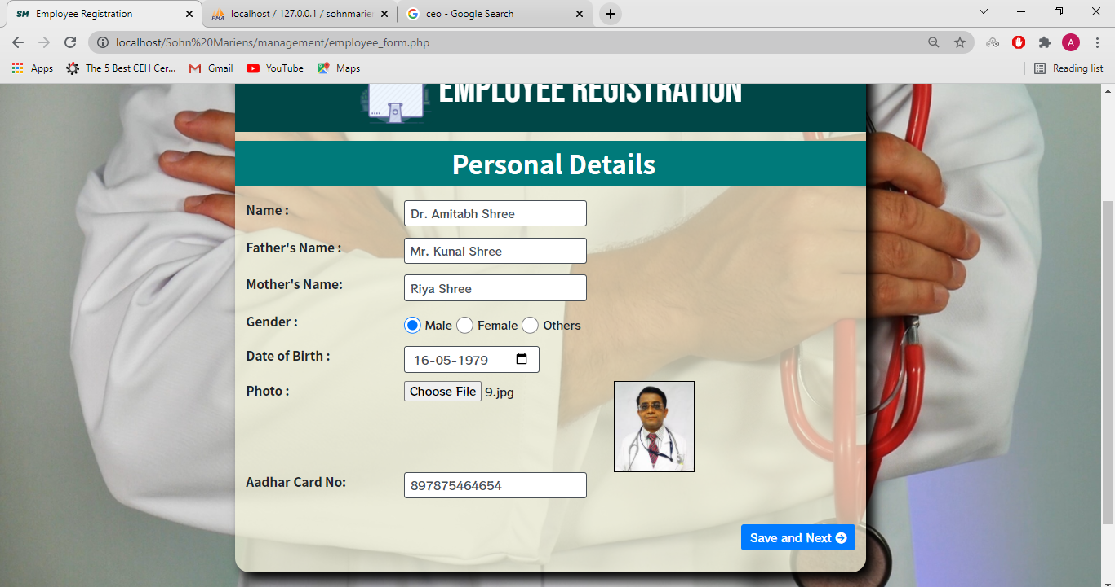

Slide 29
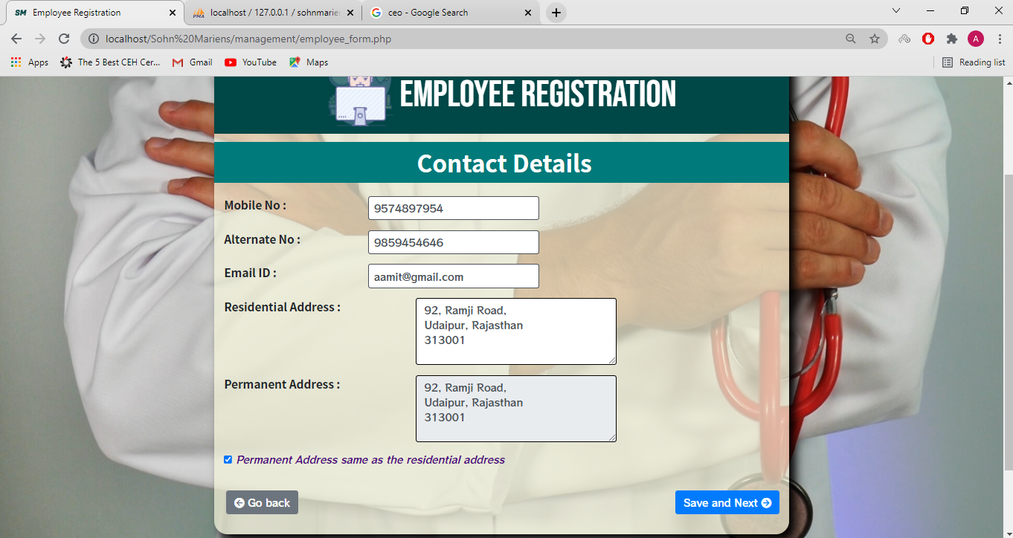

Slide 30
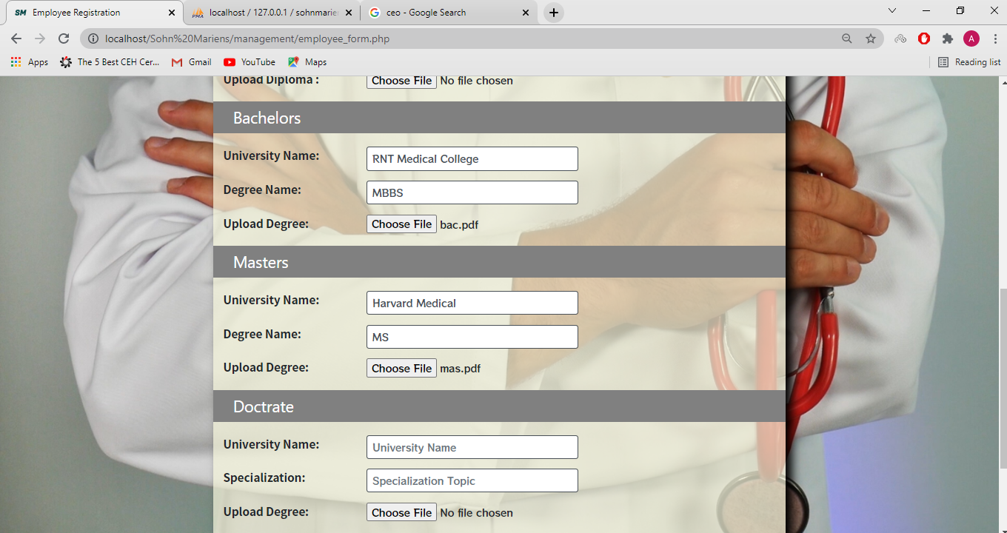

Slide 31
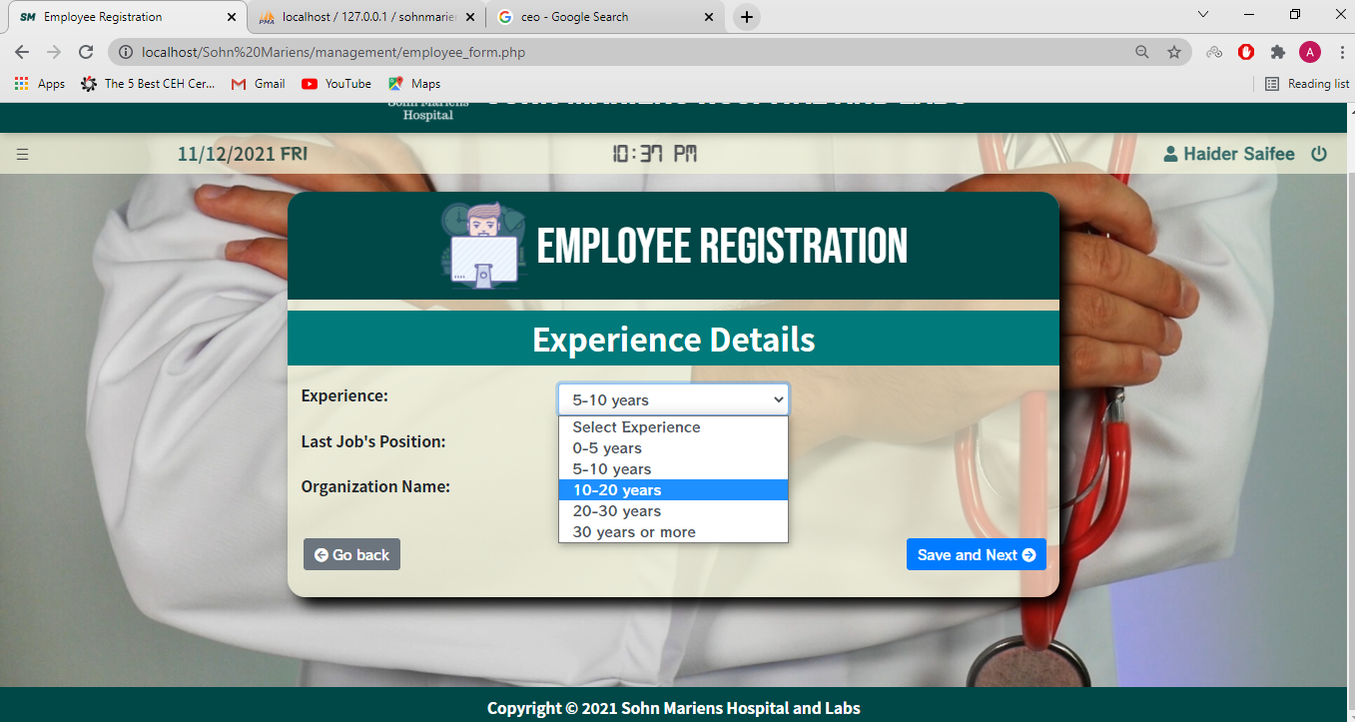

Slide 32
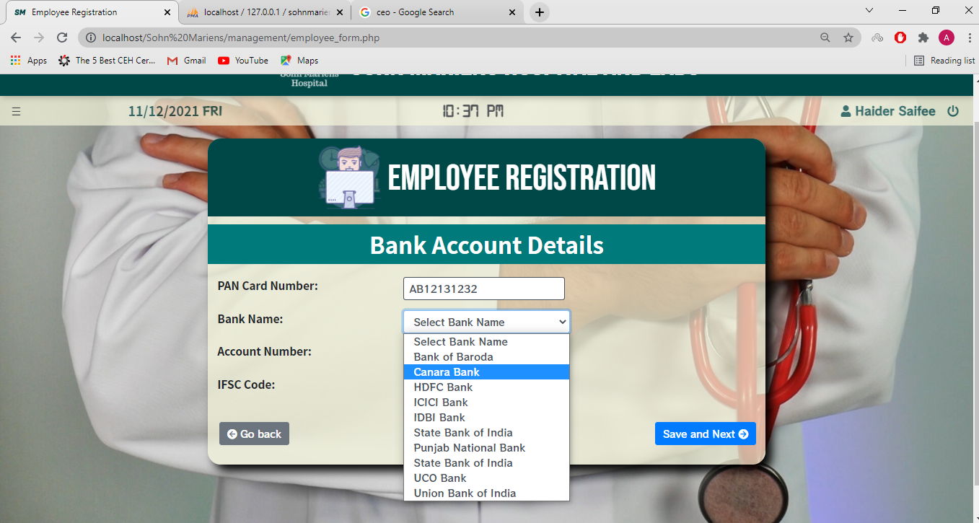

Slide 33
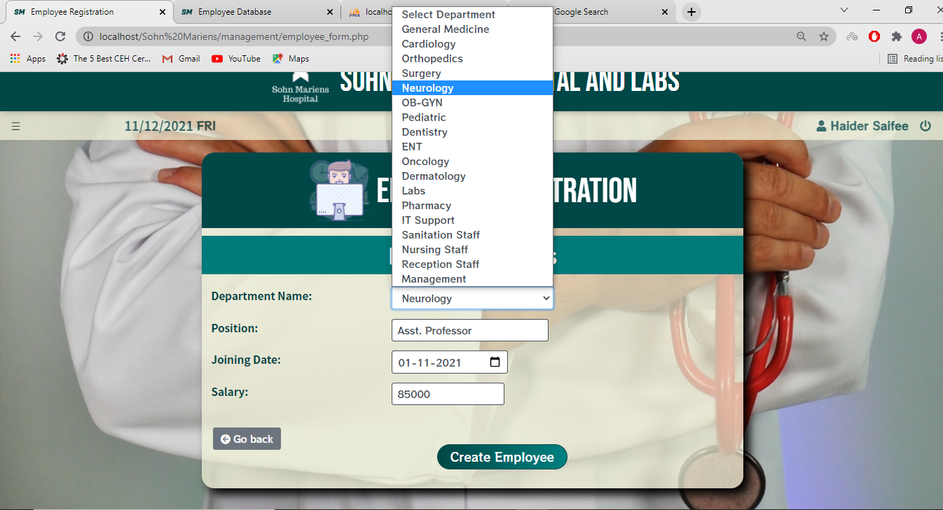

Slide 34
Employee Details:
This functionality displays the employee details and provides gateway for viewing and modifying employee files.

Slide 35
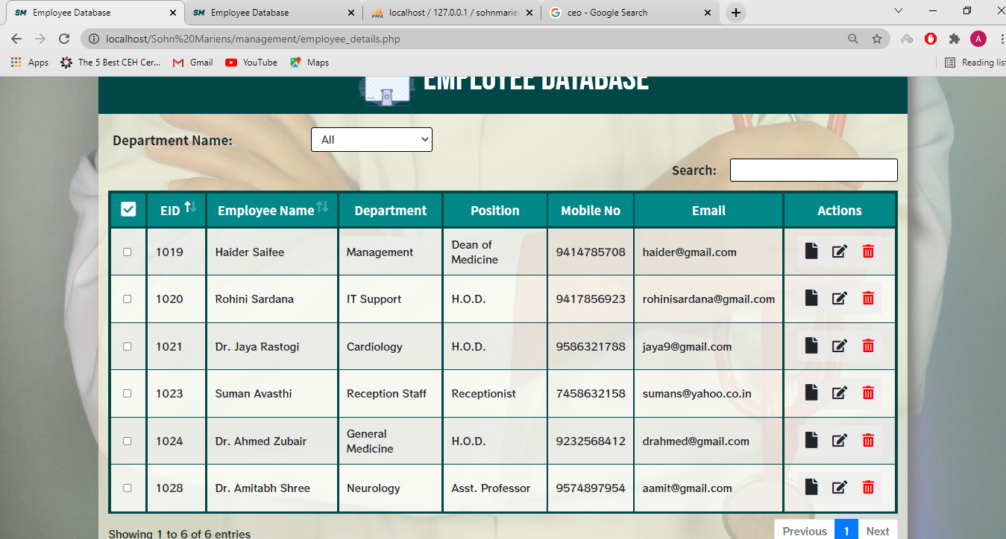

Slide 36
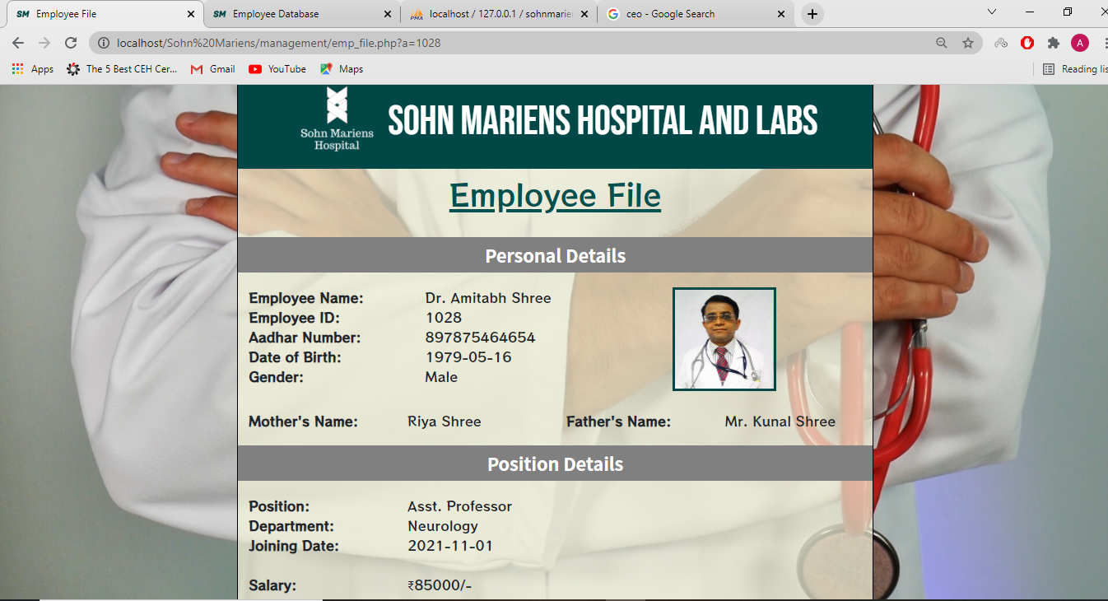

Slide 37
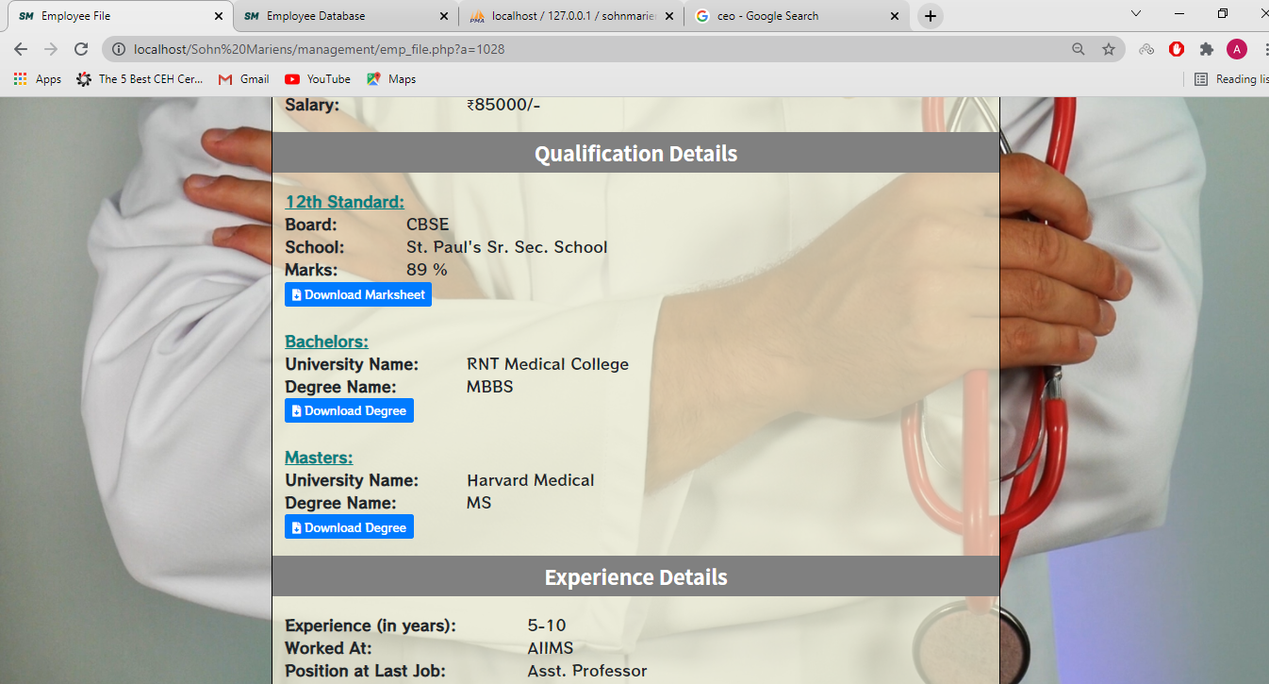

Slide 38
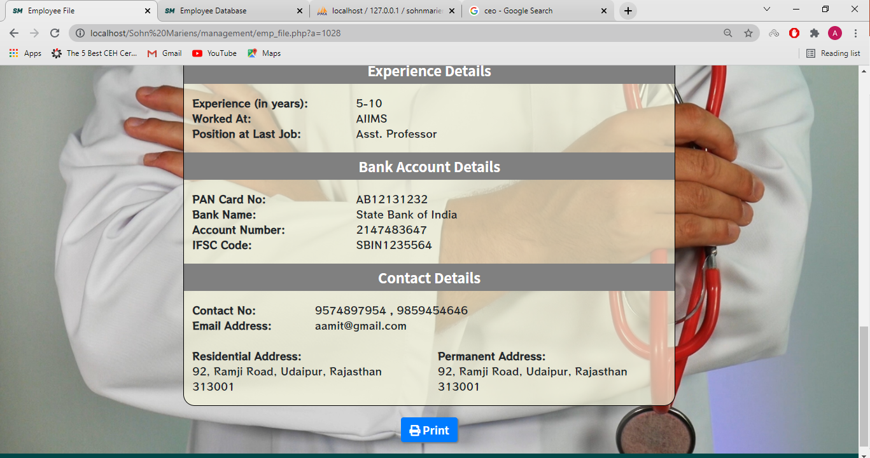

Slide 39
Doctor’s Schedules:
This functionality allows the management staff to view, set and change the schedule of the doctors in the hospital.

Slide 40
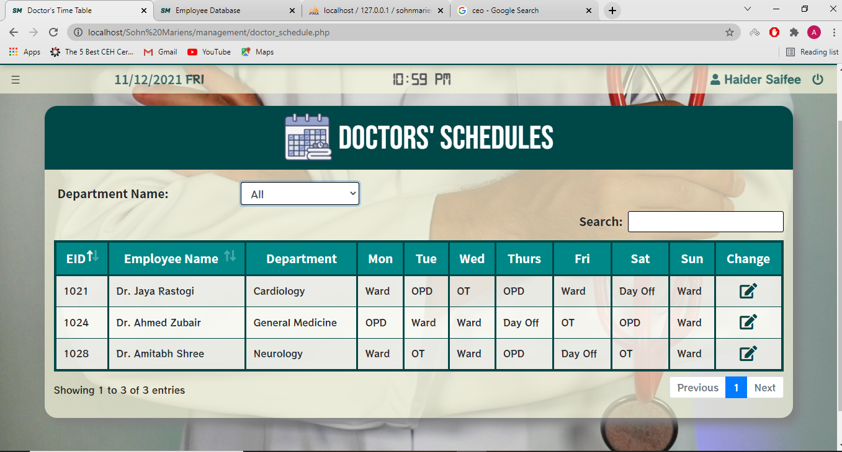

Slide 41
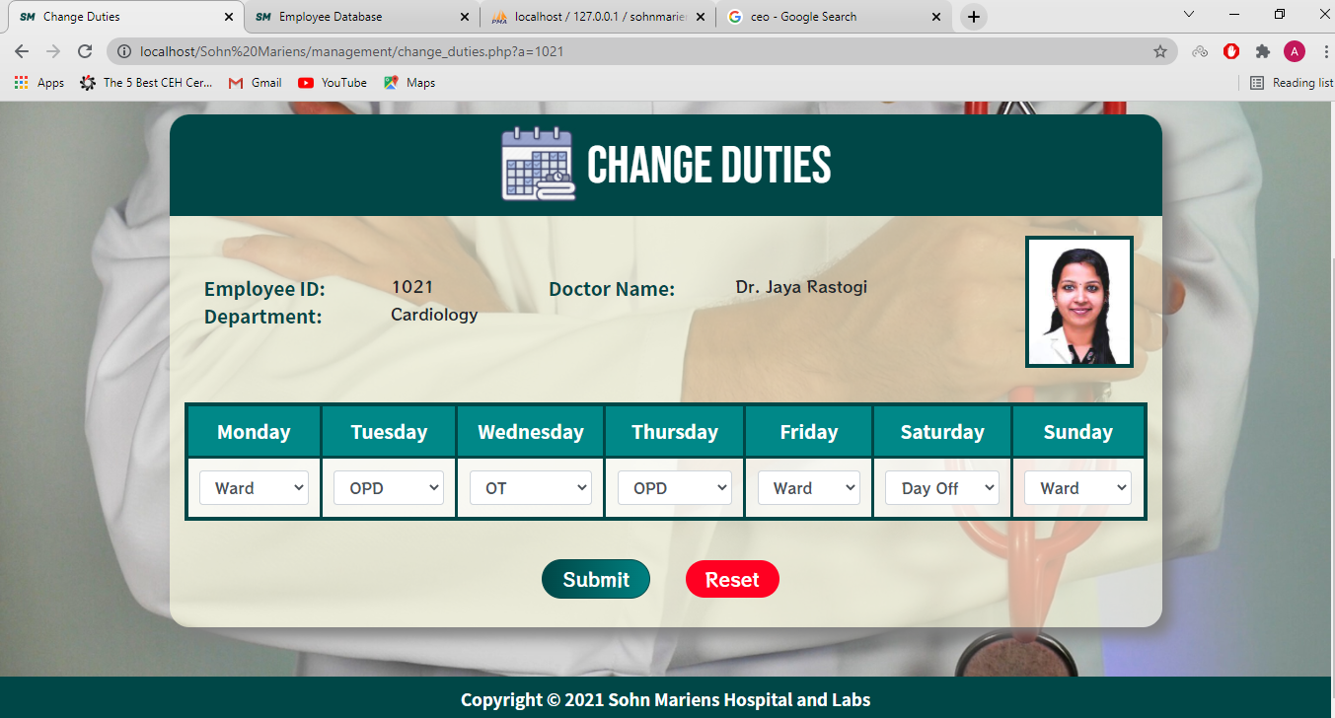

Slide 42
Appointment Details:
This functionality shows the details of the appointments booked in the hospital.

Slide 43
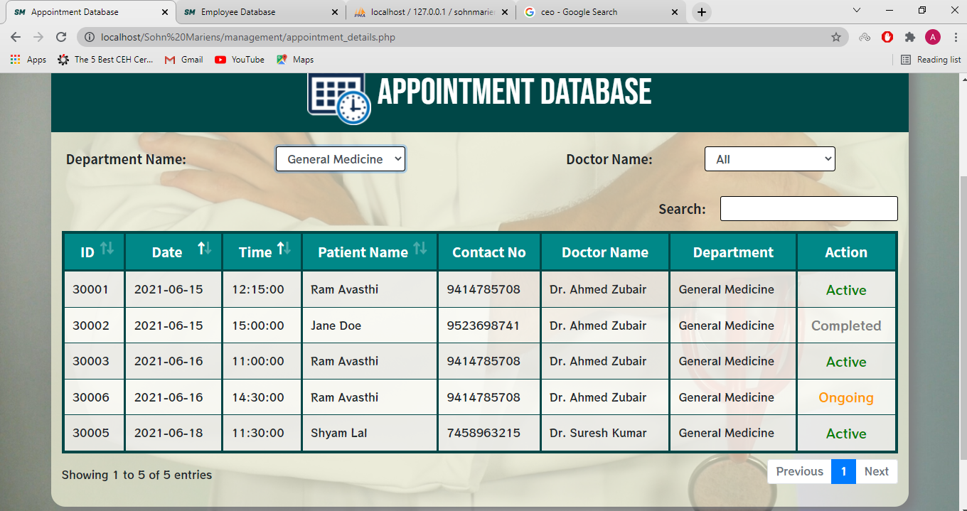

Slide 44
Admit Details:
This functionality shows the details of the patients that are admitted in the hospital.

Slide 45
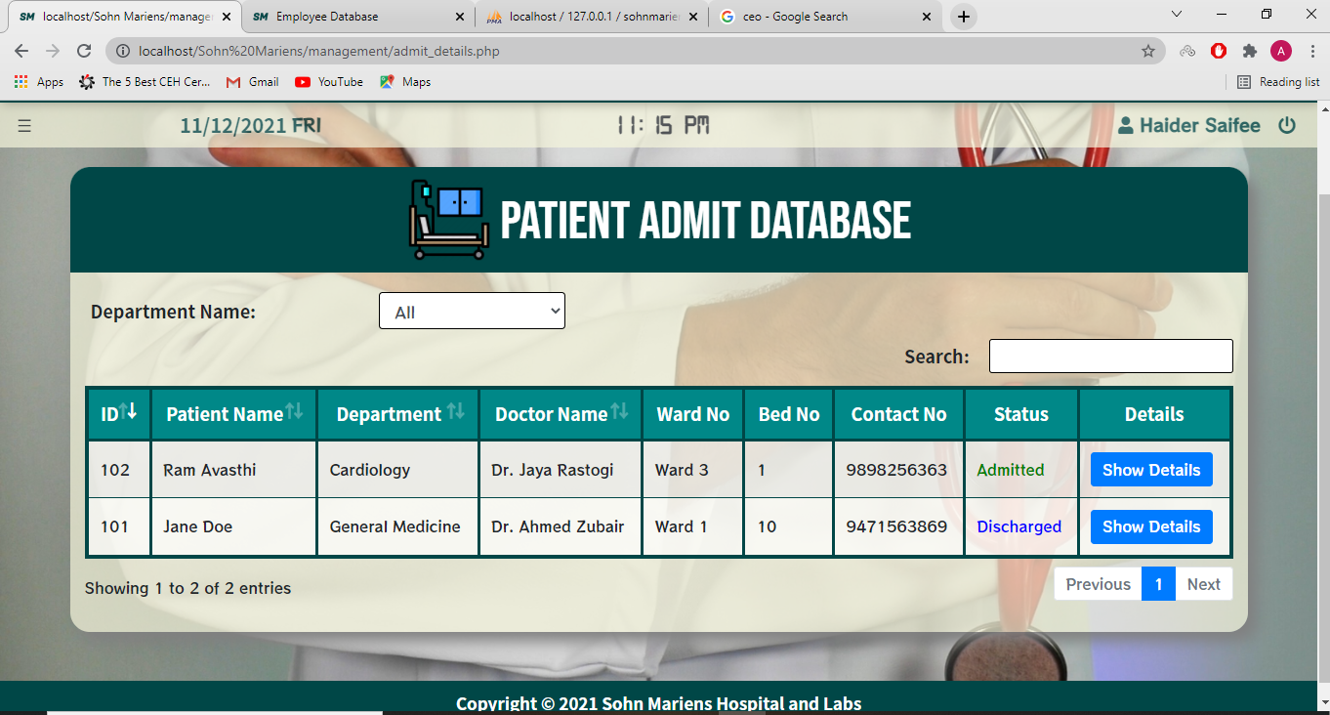

Slide 46
Parcel Details:
This functionality shows the details of all the parcels accepted in the hospital.

Slide 47
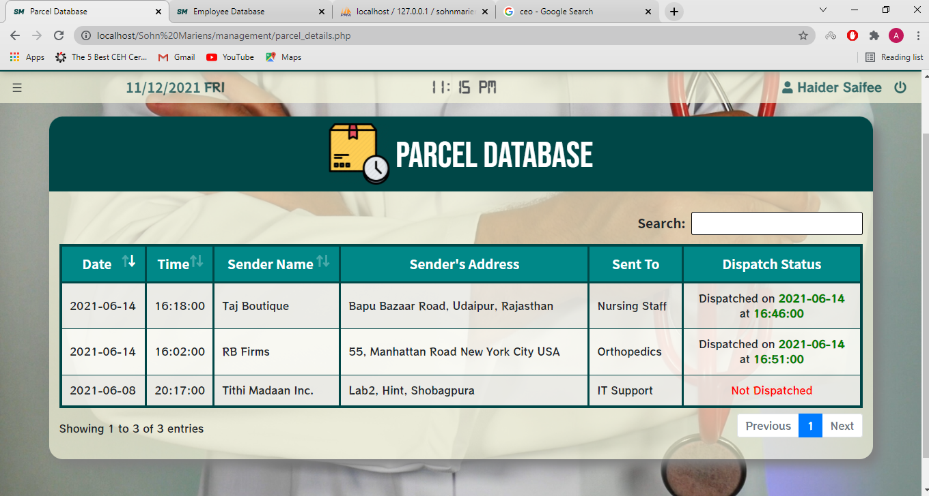

Slide 48
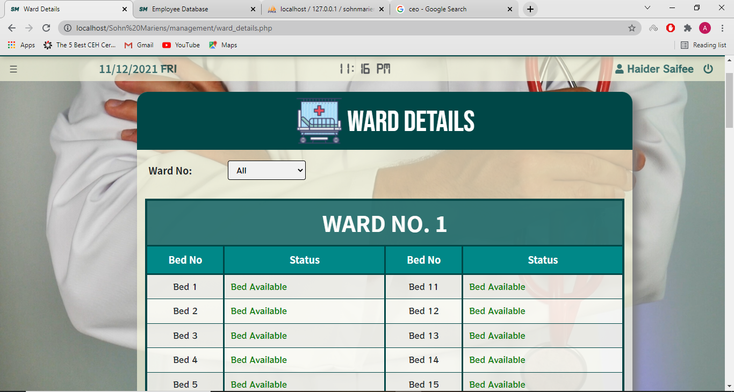

Slide 49
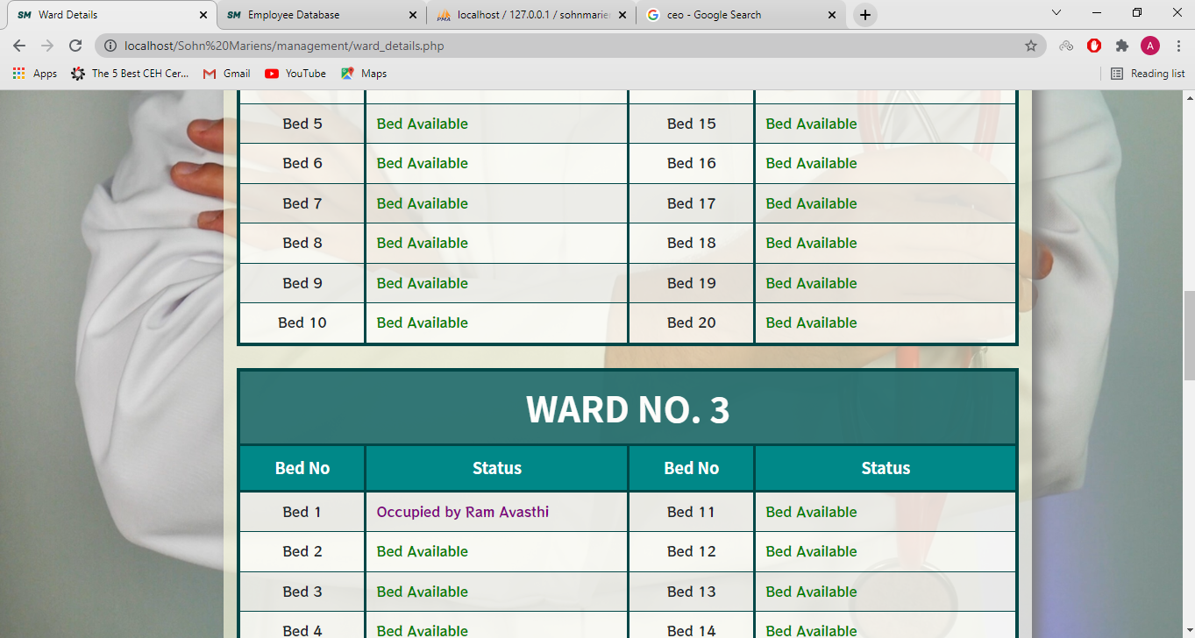

Slide 50
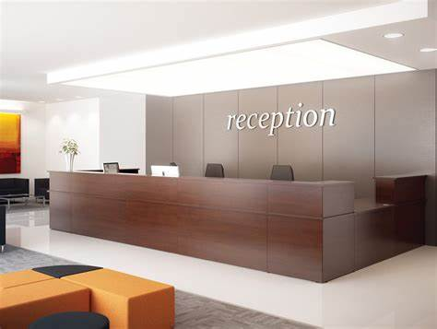
Reception Module:

Slide 51
Dashboard:
The dashboard of reception module contains the information about the doctors who have appointment duties on that day.
It also contains the appointment details for that day.

Slide 52
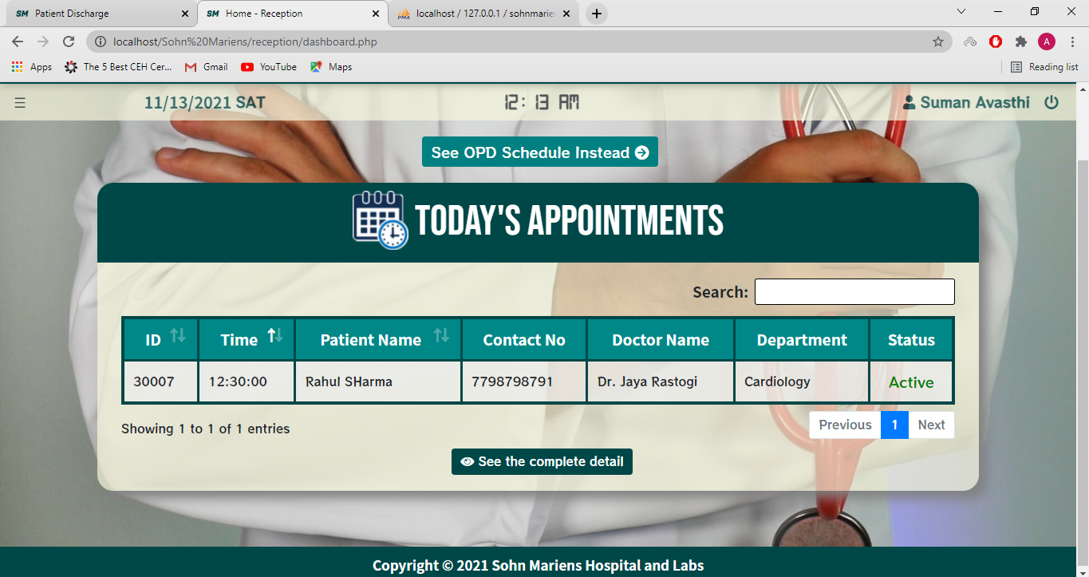

Slide 53
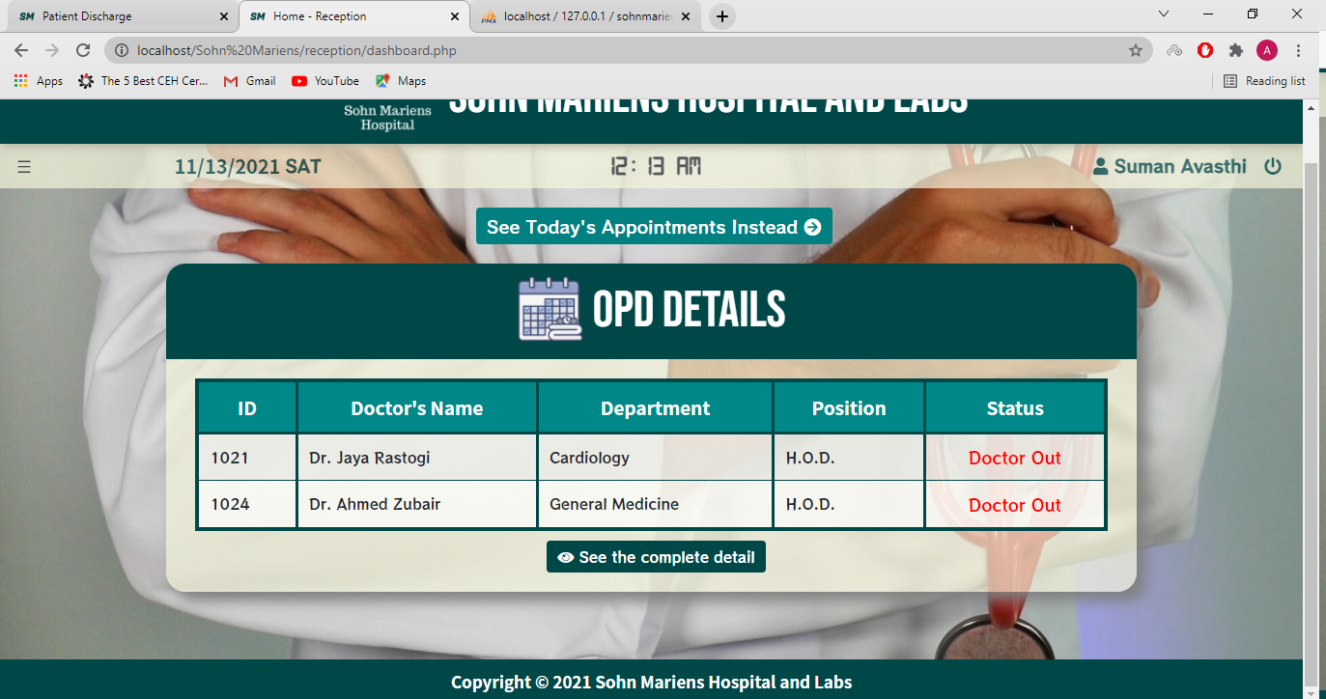

Slide 54
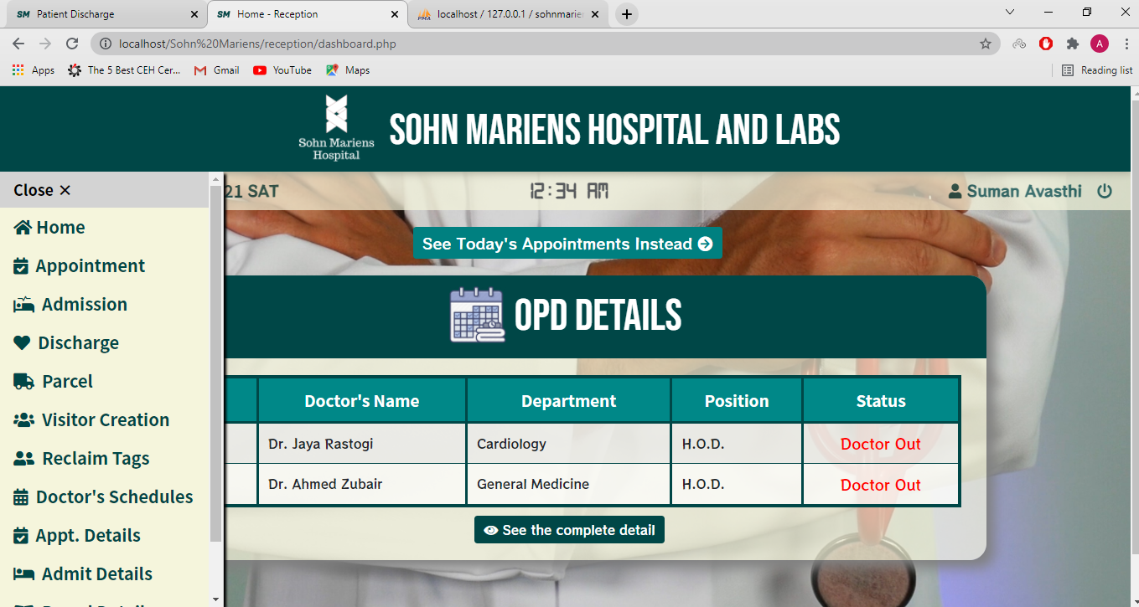

Slide 55
Appointment Form:
This functionality is used for creating appointments for the patients that visit the hospital.

Slide 56
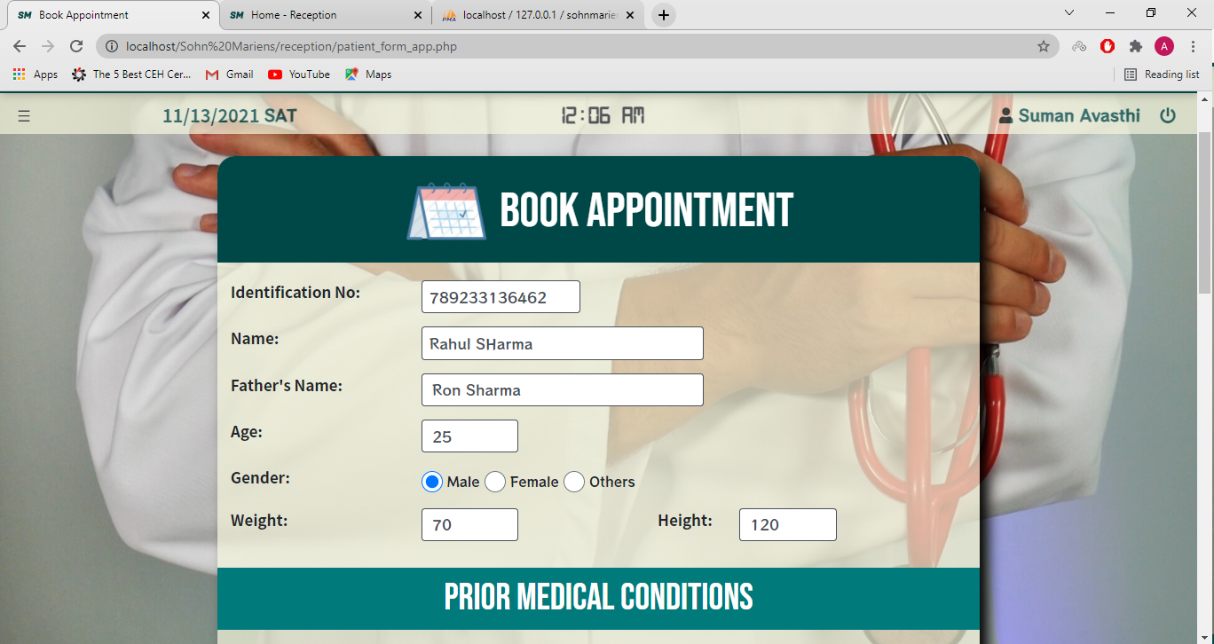

Slide 57
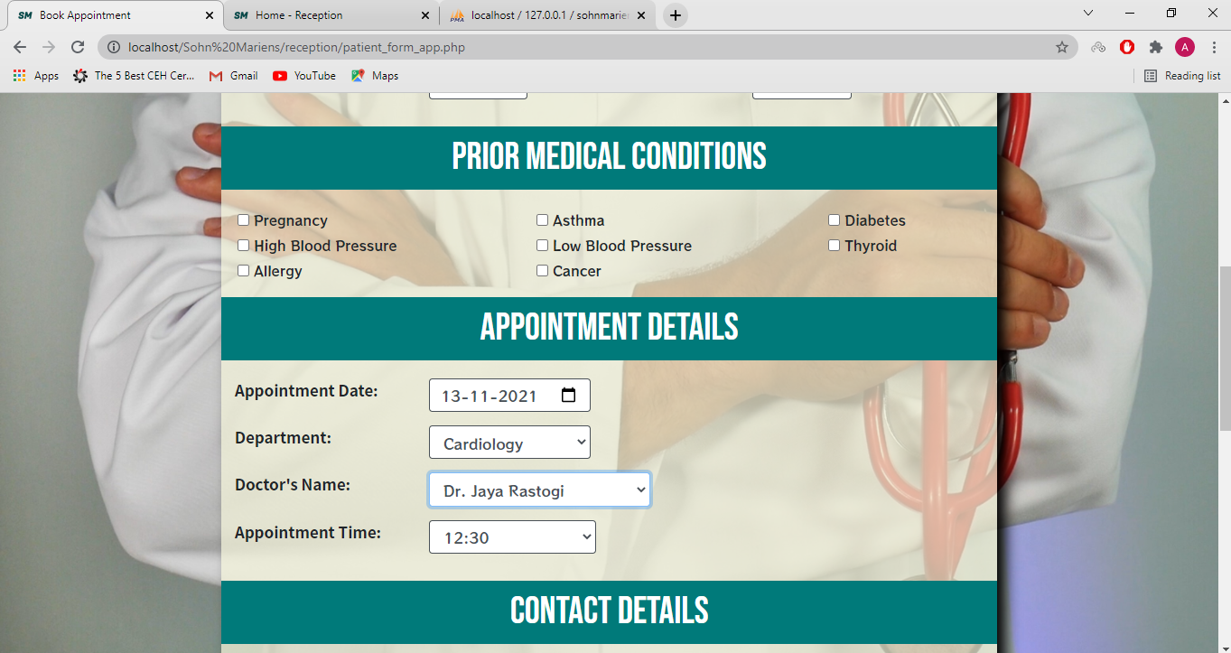

Slide 58
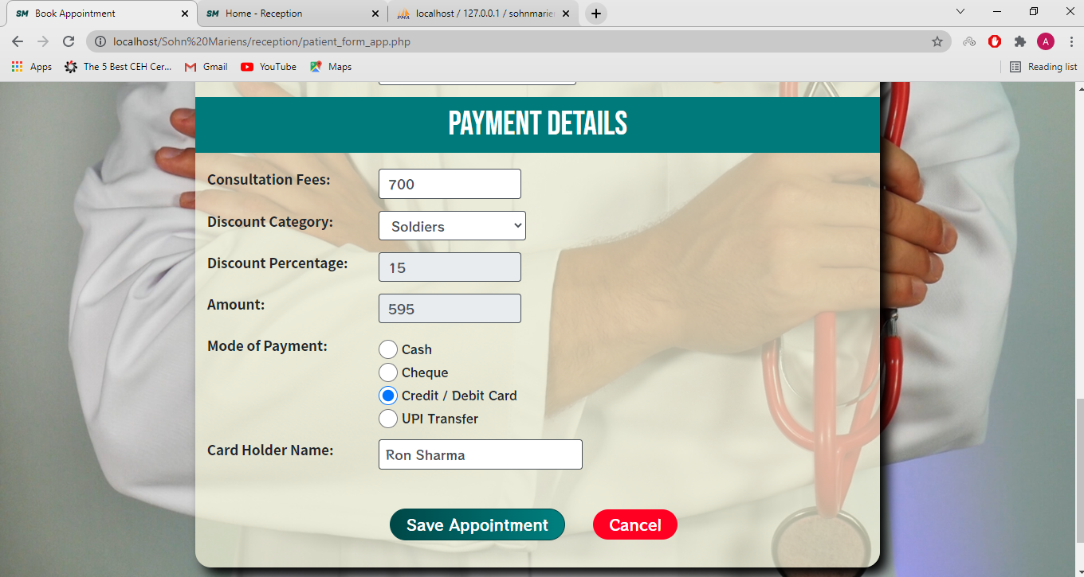

Slide 59
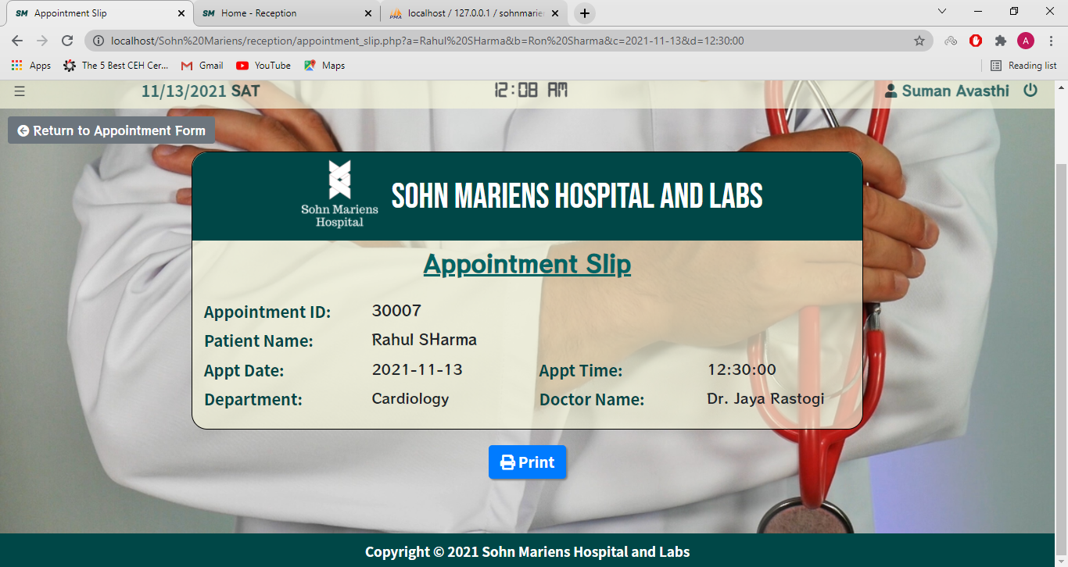

Slide 60
Appointment Database:
This functionality allows the reception staff to start and delete the created appointments.

Slide 61
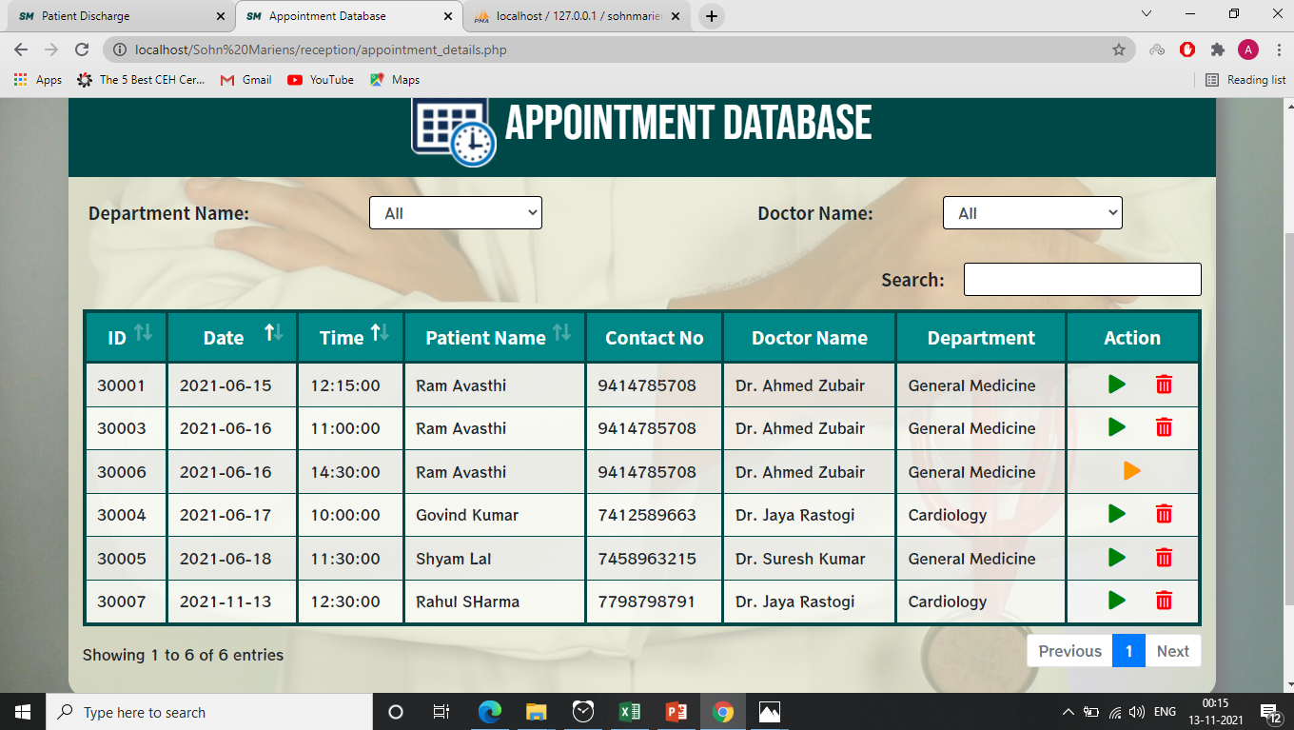

Slide 62
Admit Form:
This functionality allows the reception staff to do the necessities to admit a patient in one of the five wards available at the Sohn Mariens Hospital.

Slide 63
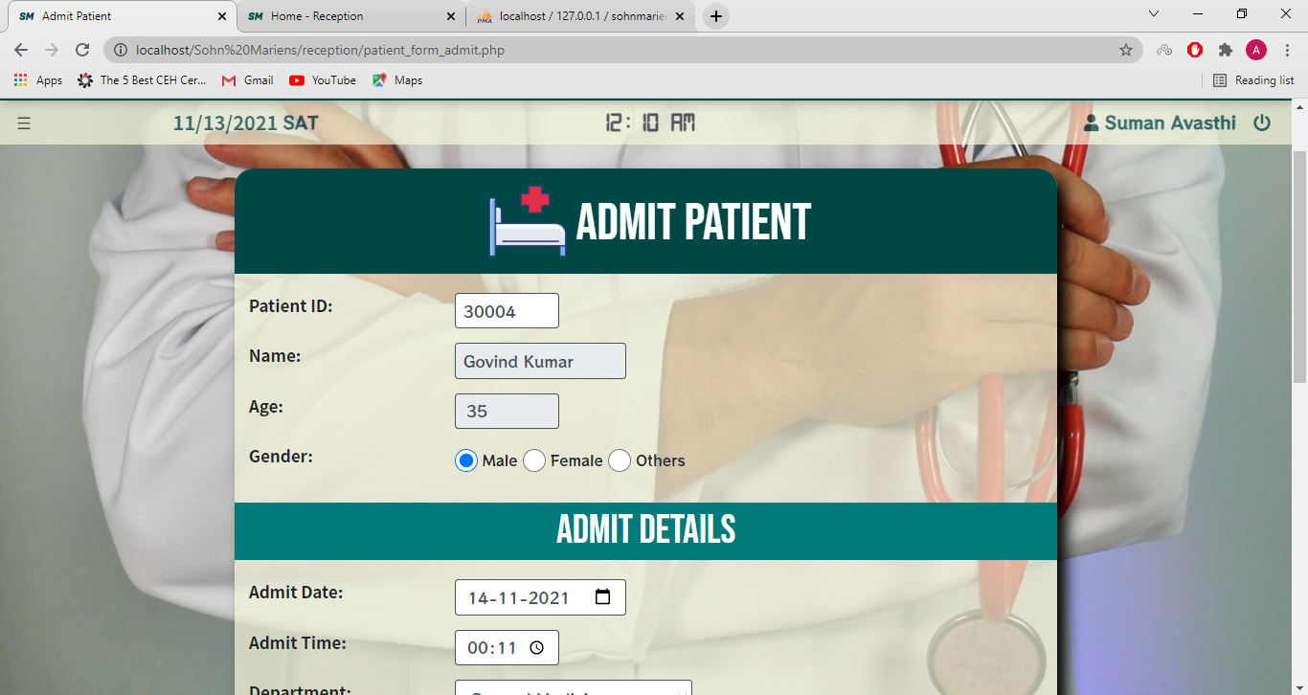

Slide 64
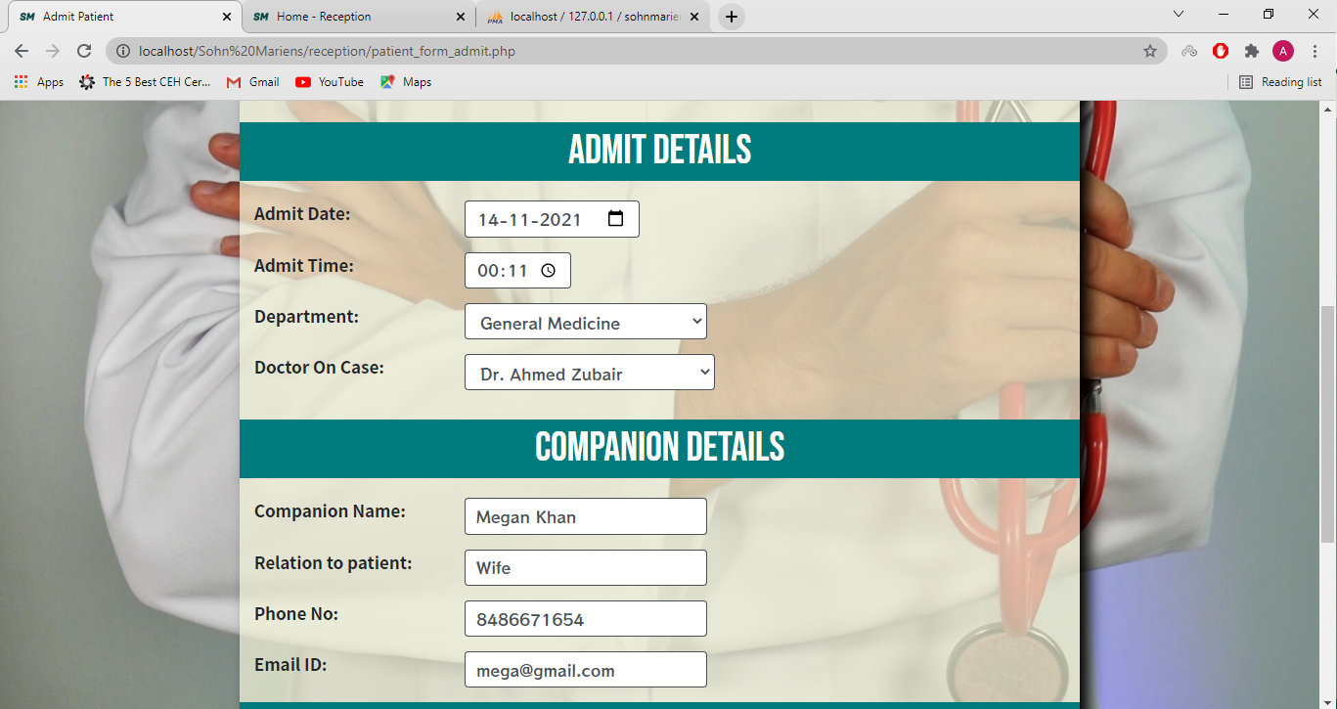

Slide 65
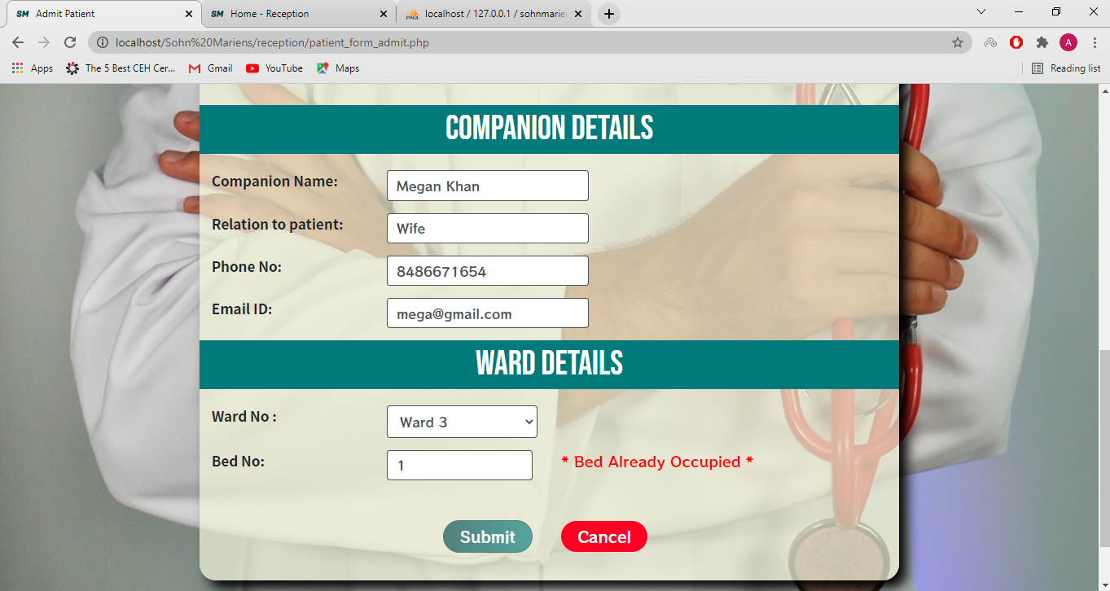

Slide 66
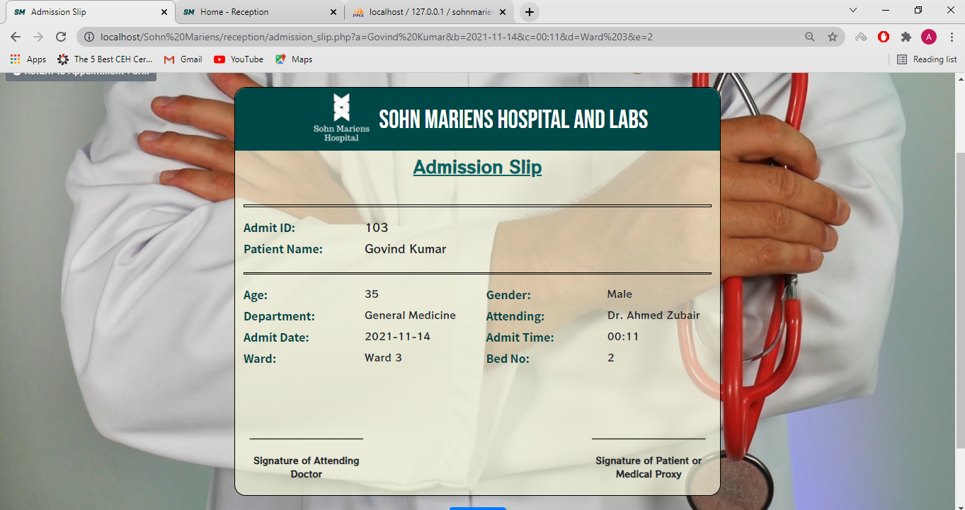

Slide 67
Admit Database:
This functionality is used to display the details of the admitted patients

Slide 68
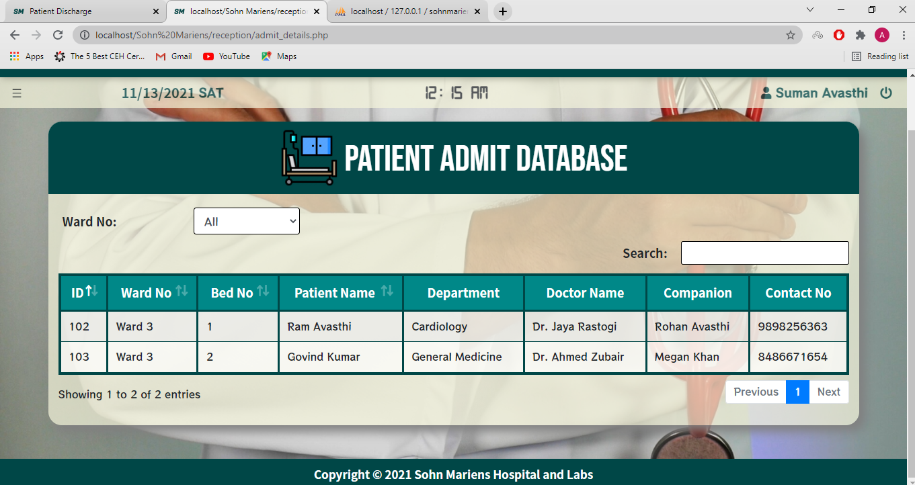

Slide 69
Patient Discharge:
This functionality deals with the discharging of the admitted patients.

Slide 70
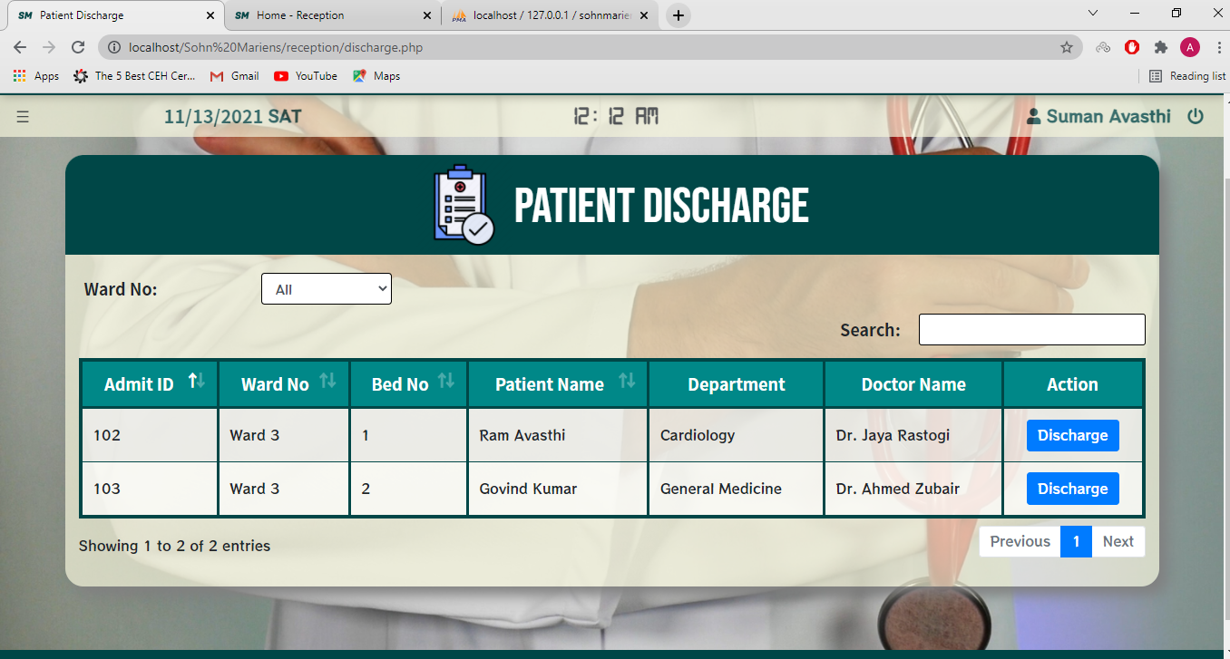

Slide 71
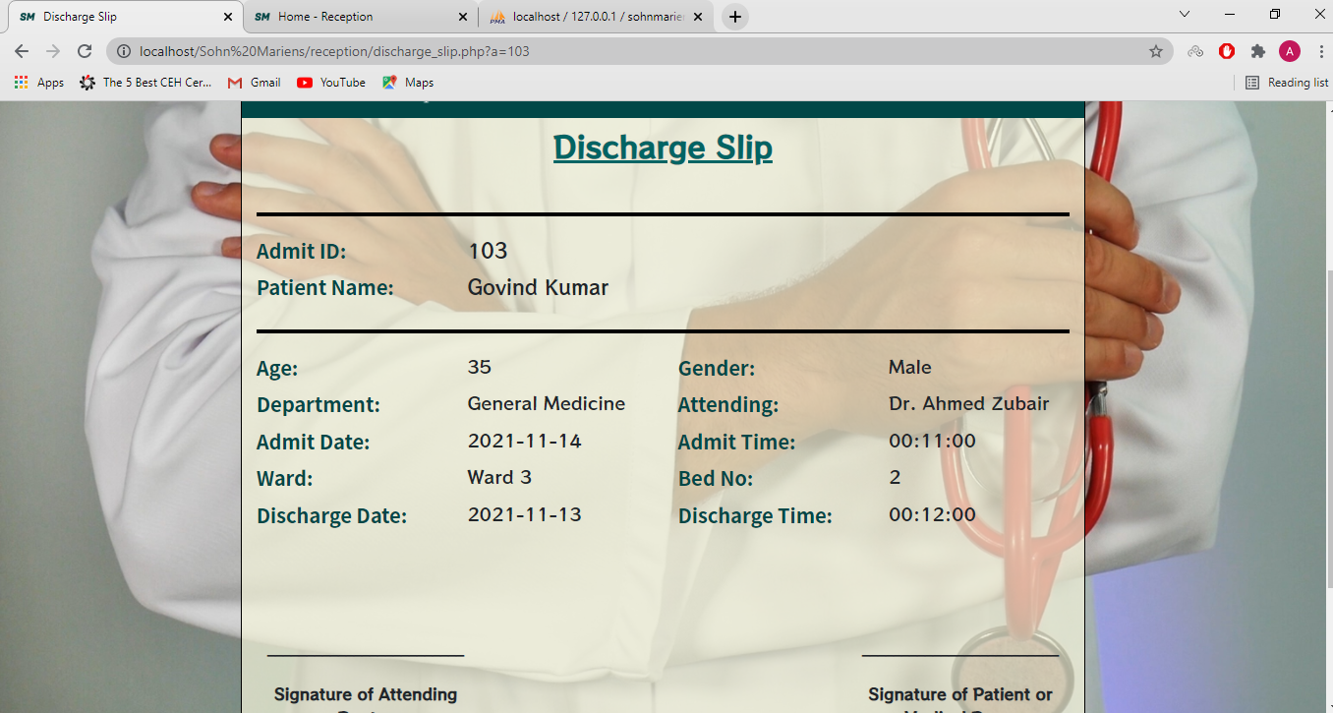

Slide 72
Creating and Reclaiming Visitor Tags:
This functionality is used to create two visitor tags for the relatives and family members of the admitted patients. Once the tags are printed, it does not allow reprinting of tags.
Also, it is used to reclaim visitor tags when the patient is discharged.

Slide 73
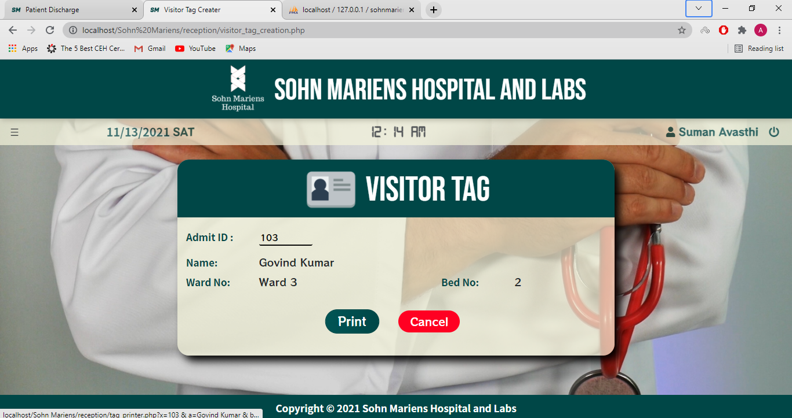

Slide 74
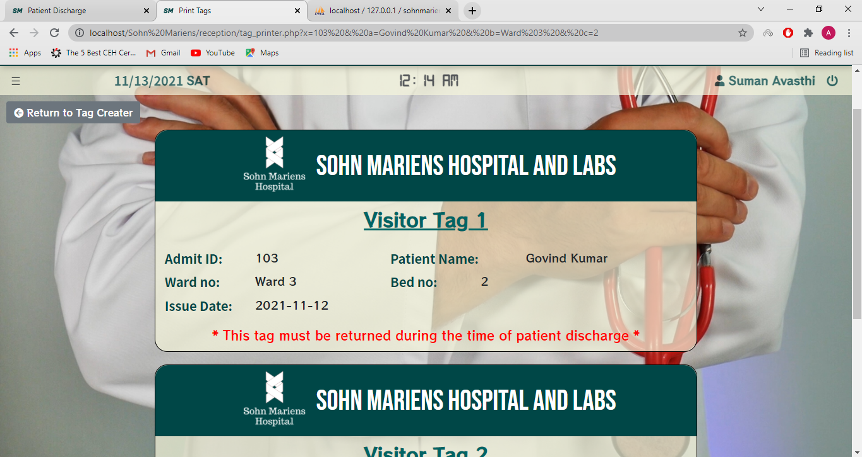
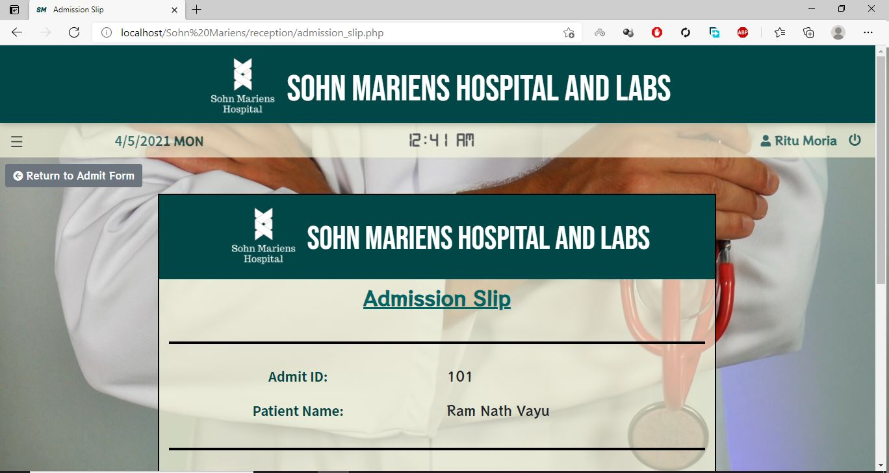

Slide 75
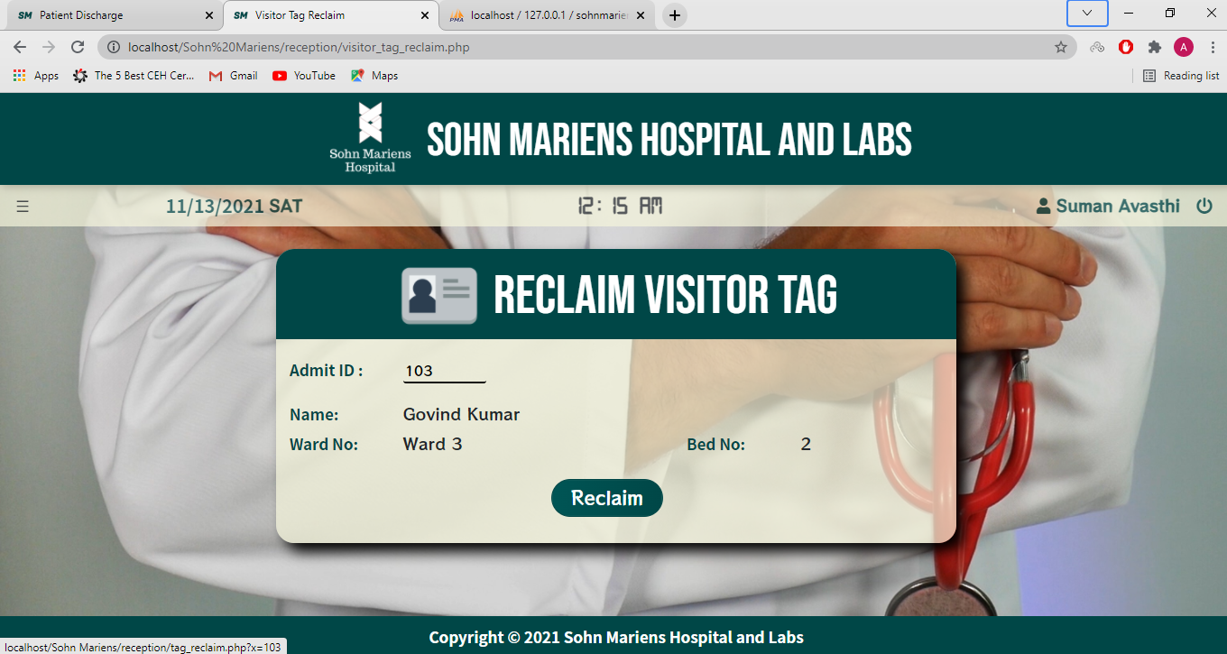

Slide 76
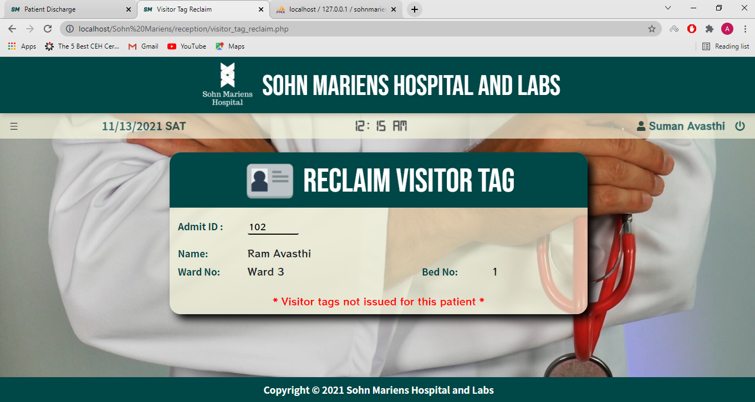

Slide 77
Parcel Form:
This functionality is used to audit the parcels received in the hospital.

Slide 78
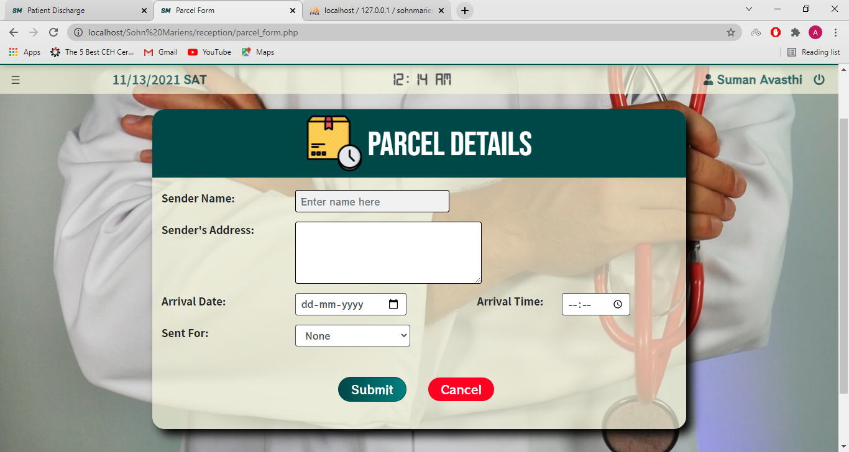

Slide 79
Parcel Database:
This functionality allows the reception staff to know about and dispatch the parcels that arrive at the main door of the hospital.

Slide 80
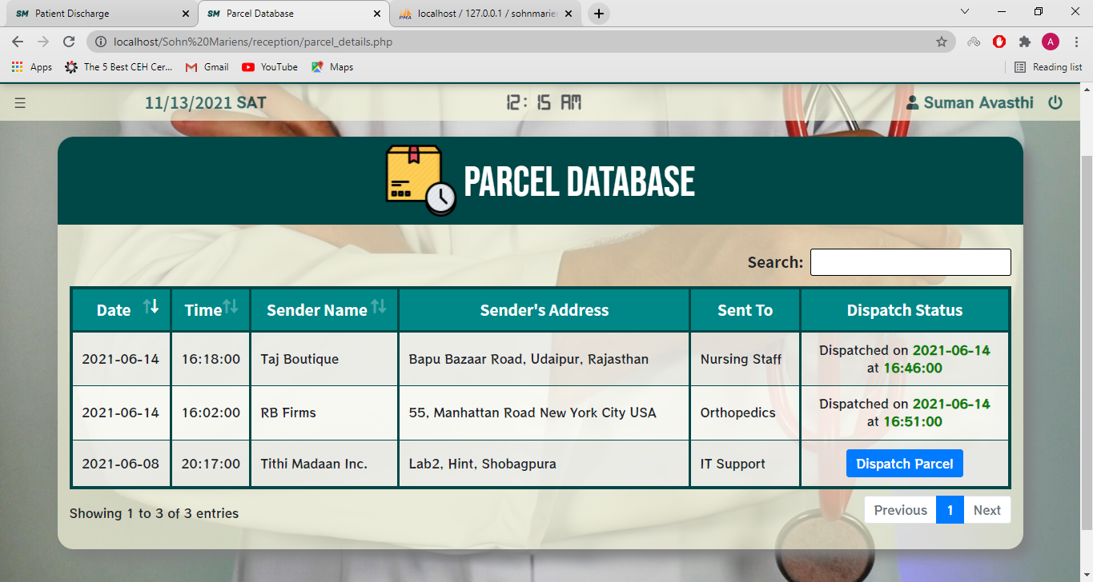

Slide 81

IT Support Module:

Slide 82
Dashboard:
The dashboard of the I.T. Dept. module contains the table containing the login and logout details of every staff member.

Slide 83


Slide 84


Slide 85
Create User:
This functionality creates the user which are used by the staff members to log on to the Sohn Mariens Hospital Management System.

Slide 86


Slide 87
User Access Manager:
This functionality is used to temporarily enable or disable any user. This is used to provide extra security if a staff member plans to be inactive for a long period of time.

Slide 88


Slide 89
Reset Password:
This functionality allows the IT staff to reset the passwords of a user in case of a forgotten password.

Slide 90


Slide 91


Slide 92
Delete User:
This functionality is used to delete the users accounts of the employees.

Slide 93


Slide 94

Doctor Module:

Slide 95
Dashboard:
The dashboard of doctor module shows the weekly schedule of the specific doctor.

Slide 96


Slide 97
My Appointments:
This functionality shows the appointments of the doctors. Moreover, it provides the gateway to prescription module.

Slide 98


Slide 99


Slide 100


Slide 101
My Admit Cases:
This functionality shows the details of the admitted patients of the doctor.

Slide 102


Slide 103
My Patients:
This module shows the details of the patients of each doctor.

Slide 104


Slide 105
Database Structure:

Slide 106

Sohn Mariens:

Slide 107

Admit Table:

Slide 108

Department Table:

Slide 109

Duties Table:

Slide 110

Employee Table:

Slide 111

Employee Table:

Slide 112

Login Users Table:

Slide 113

Medicine Table:

Slide 114

Parcel Table:

Slide 115

Patient Table:

Slide 116
Abstraction:
The aim of the proposed system is to develop a system of improved facilities for managing the assets in a hospital, pharmacy and diagnostic labs.
The proposed System overcomes all the limitations of the existing system. The system provides proper security and reduce the manual work.

Slide 117
Future Scope:
The software will be able to include a client for mail server so that communication for the employees could be eased.
The admission, discharge and appointment features will be accompanied by bill creating software.
An independent payment gateway will be included in the software.
In future, a module for diagnostic labs and pharmacy can be integrated with it.

Slide 118
Thank You

